Slide 1

SQL Injection
Barbara Vitoria, Cristhofer Chow, Miguel Castro

Slide 2
O que é ?

Slide 3
Tipos de
SQL Injection

Slide 4
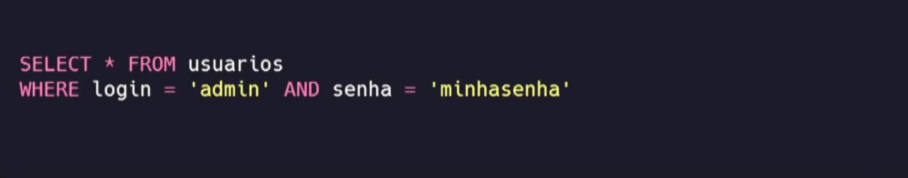
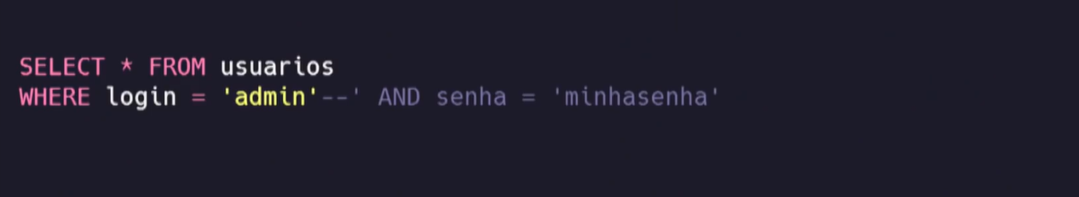
In-Band SQL Injection
In-Band SQL Injection

Slide 5
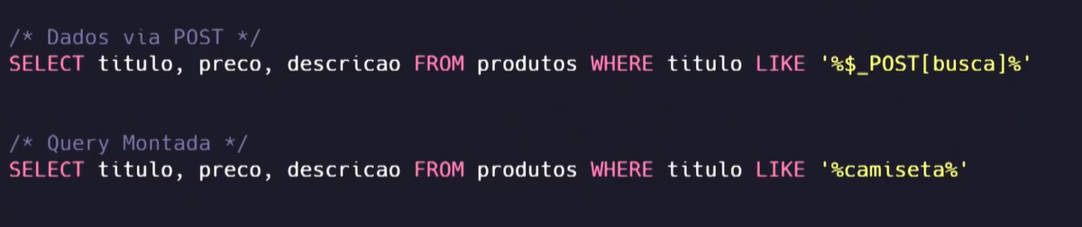
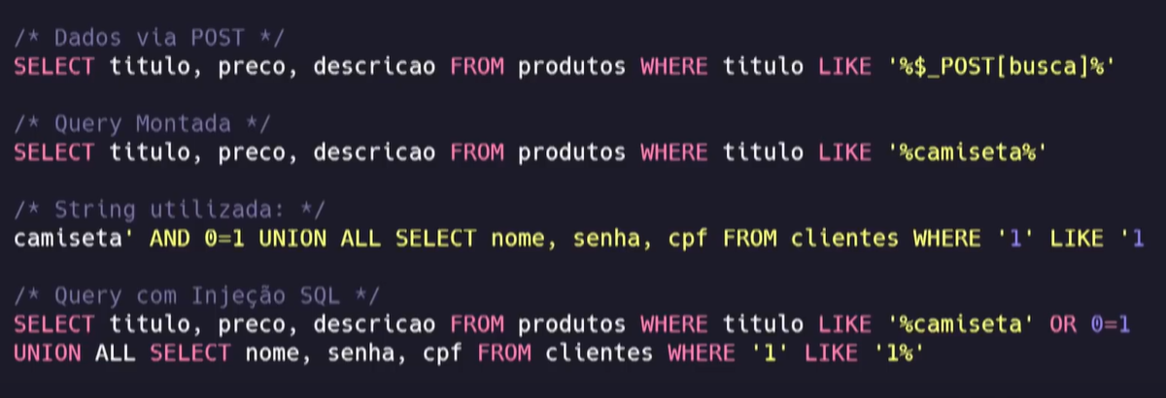
Union-Based SQL Injection
Union-Based SQL Injection

Slide 6
Blind SQL Injection
Blind SQL Injection

Slide 7
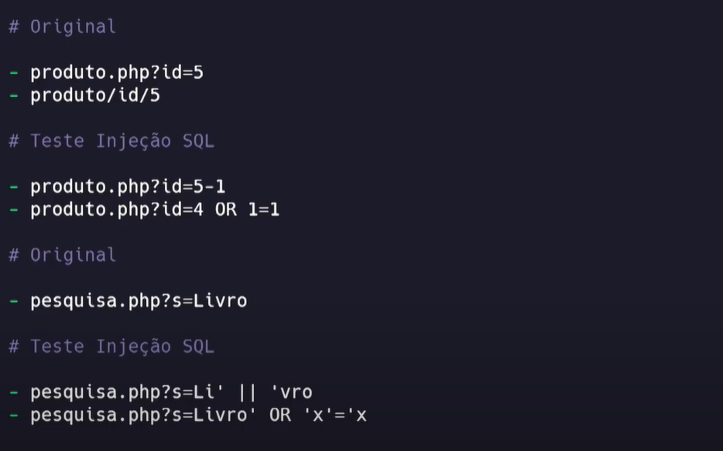
SQL Tautology Injection
SQL Tautology Injection

Slide 8
Exemplo

Slide 9
REPOs
https://github.com/cristhoferChow/ExemploSiteVulneravel
https://github.com/jussimar/ExemploSiteVulneravel
Bibliografia
https://www.youtube.com/watch?v=8lHuQImnIZU
https://www.youtube.com/watch?v=jN8QGOxdhvM
https://www.devmedia.com.br/sql-injection/6102
https://www.w3schools.com/sql/sql_injection.asp
https://juice-shop.herokuapp.com/#/search

